Slide 1
A LOVING HOME FOR EVERY CHILD
Worldskills
Abu Dhabi 2017
https://www.youtube.com/watch?v=F2dBugdBzMM
Notes:
SPEAKER‘S NOTES:
[This opening slide can be tailored to the specific situation in which it will be used, for example by adding your name and the location and date it will be presented.]
[This first slide is an opportunity to introduce yourself and why you are there, for example: ‚Today I would like to tell you about SOS Children‘s Villages and how we strive to achieve our ultimate goal: A loving home for every child.‘]

Slide 2
WHY we do what we do...
Notes:
SPEAKER‘S NOTES:
First of all, let‘s have a look at WHY we do what we do, and the circumstances that make our work indispensable…

Slide 3
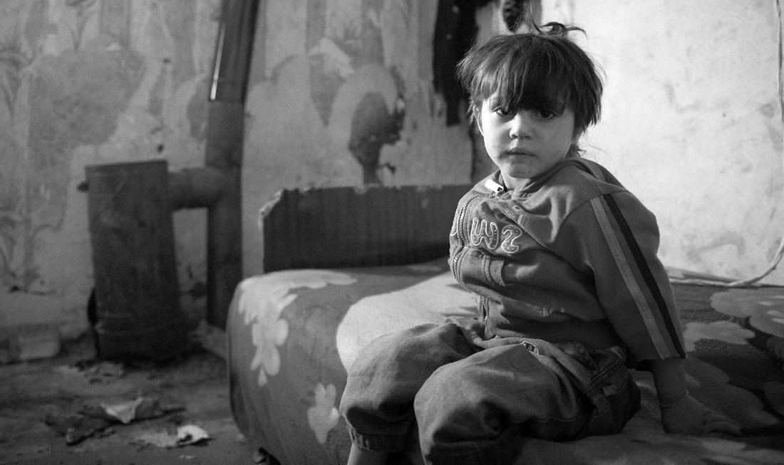
151 MILLION children worldwide
have lost one or both parents.
UNICEF 2011
Notes:
SPEAKER‘S NOTES:
All over the world, millions of children are growing up without the care of their parents, without any supervision and in brutal living conditions.

Slide 4
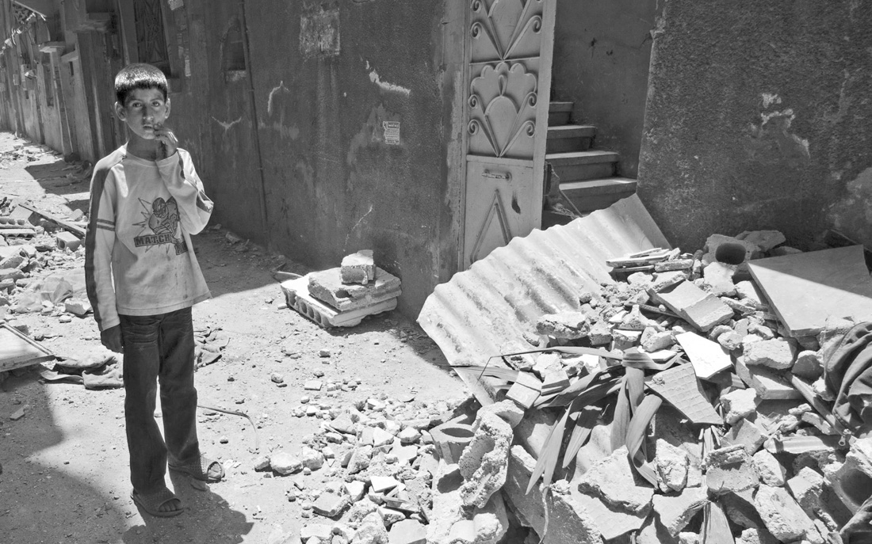
Over 1 BILLION CHILDREN live in countries affected by armed conflict.
UNICEF 2009
Notes:
SPEAKER‘S NOTES:
Why are so many children forced to live in such dire circumstances?
This statistic is one reason – one billion children living in countries affected by war...
[Note that 2009 is the latest figure we could find for this particular statistic]
In addition, millions of children are affected every year by natural disasters, food and water shortages, and other traumatic experiences…

Slide 5
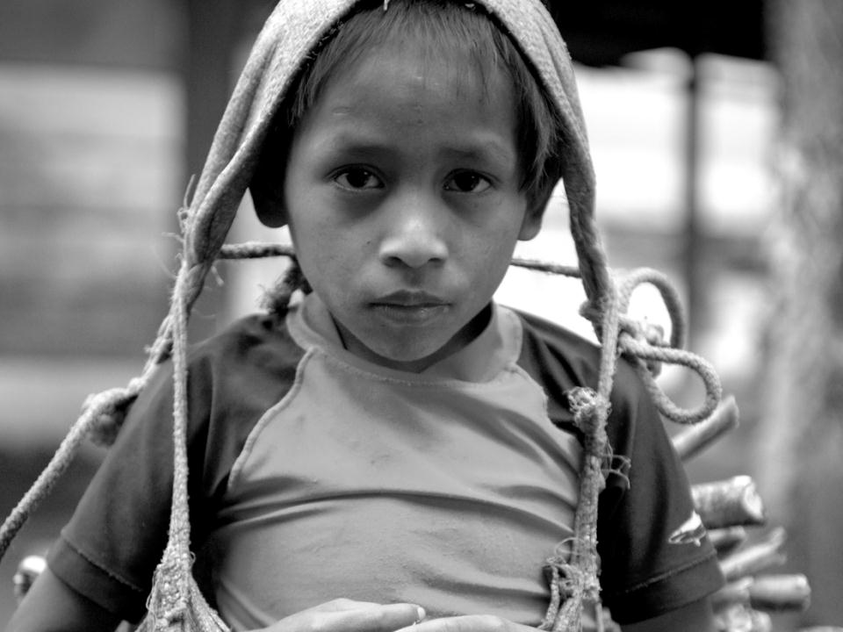
57 MILLION CHILDREN of primary school age do NOT go to school.
UNESCO 2011
Notes:
SPEAKER‘S NOTES:
Everyone agrees that education is a human right, but this statistic shows how that right is being violated.
Many children, especially girls, drop out of school to work in order to contribute to family income.
Children from poor, less educated and marginalised families are disporportionately affected.

Slide 6
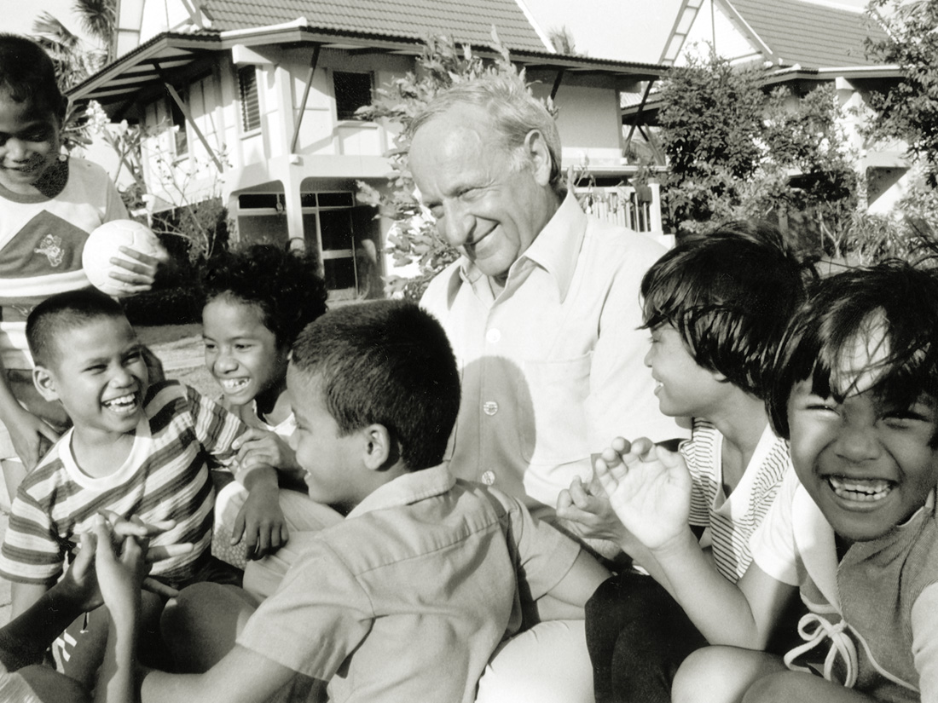
”All the children of the world are our children.”
(Hermann Gmeiner, founder of SOS Children’s Villages)
Notes:
SPEAKER‘S NOTES:
Nearly every country on earth has signed up to the UN Convention on the Rights of the Child. That was 25 years ago. And yet those statistics tell a different story.
We cannot just stand by, without doing something, while children are in that situation.
More than 60 years ago, this is what compelled our founder Hermann Gmeiner to establish SOS Children‘s Villages. The children who had lost their homes, their security and their families as a result of the Second World War compelled him to act. We follow in that tradition.
In Hermann Gmeiner‘s own words: “ALL the children of the world are OUR children”

Slide 7
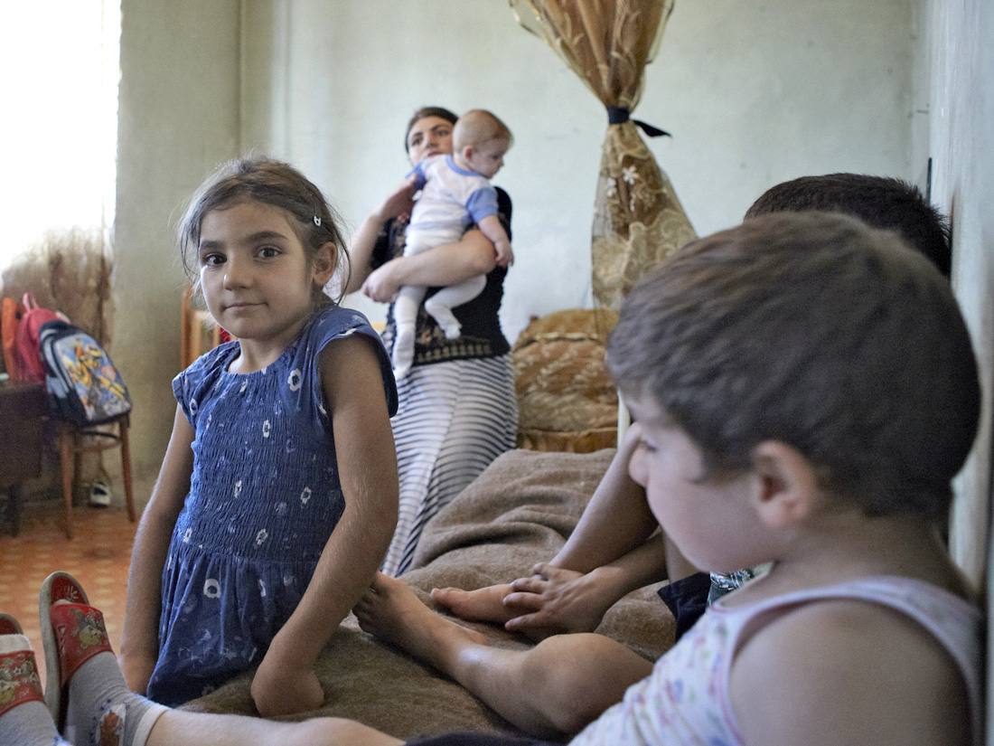
We believe that every child
needs a loving home to flourish in and we
help families around the world make it happen.
Notes:
SPEAKER‘S NOTES:
60 years ago, Hermann Gmeiner saw a solution:
He himself had been raised not by his parents, but by his older sister, so he knew that being put in an institution was not the only alternative to growing up with your biological parents. He decided to CREATE families for children who had lost their parents.
SOS Children‘s Villages now works in 134 countries and territories to support families and help children at risk grow up in a loving home.

Slide 8










































Every child is unique, and so is the way we work...
Notes:
SPEAKER‘S NOTES:
To provide a loving home, you have to recognise that every child is different. Every child comes from a different background, has different needs, different dreams.
Every child is unique. And so is the way we work.

Slide 9
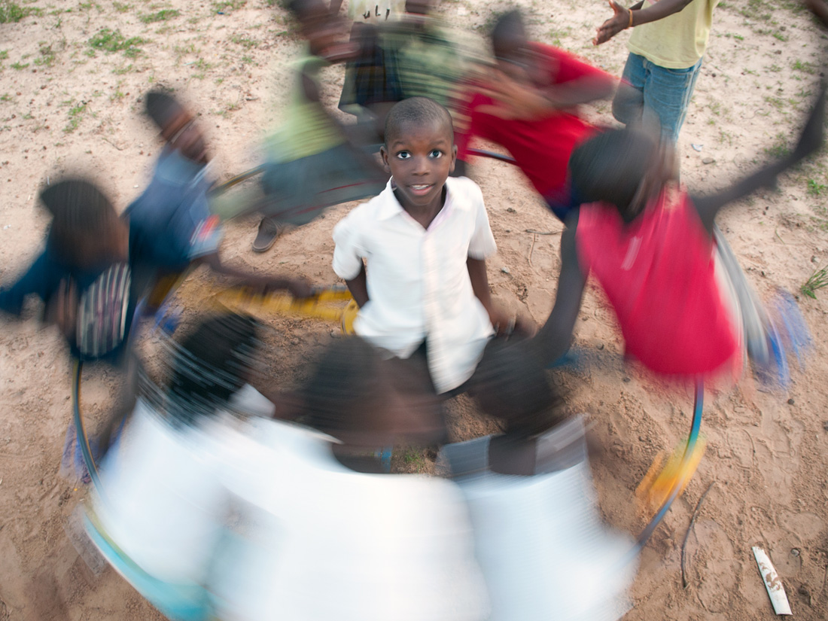
Whatever we do, the child is at the centre.
Notes:
SPEAKER‘S NOTES:
We are different because we truly put the child at the centre of everything we do.
We get to know every child in our care, and each child has an individual development plan. We talk with the children and involve them in any decisions affecting them. The individual child‘s best interests are at the heart of every decision.
Although each child is different, our experience tells us that ALL children need long term, resilient relationships, and that these are best developed in family environments.

Slide 10
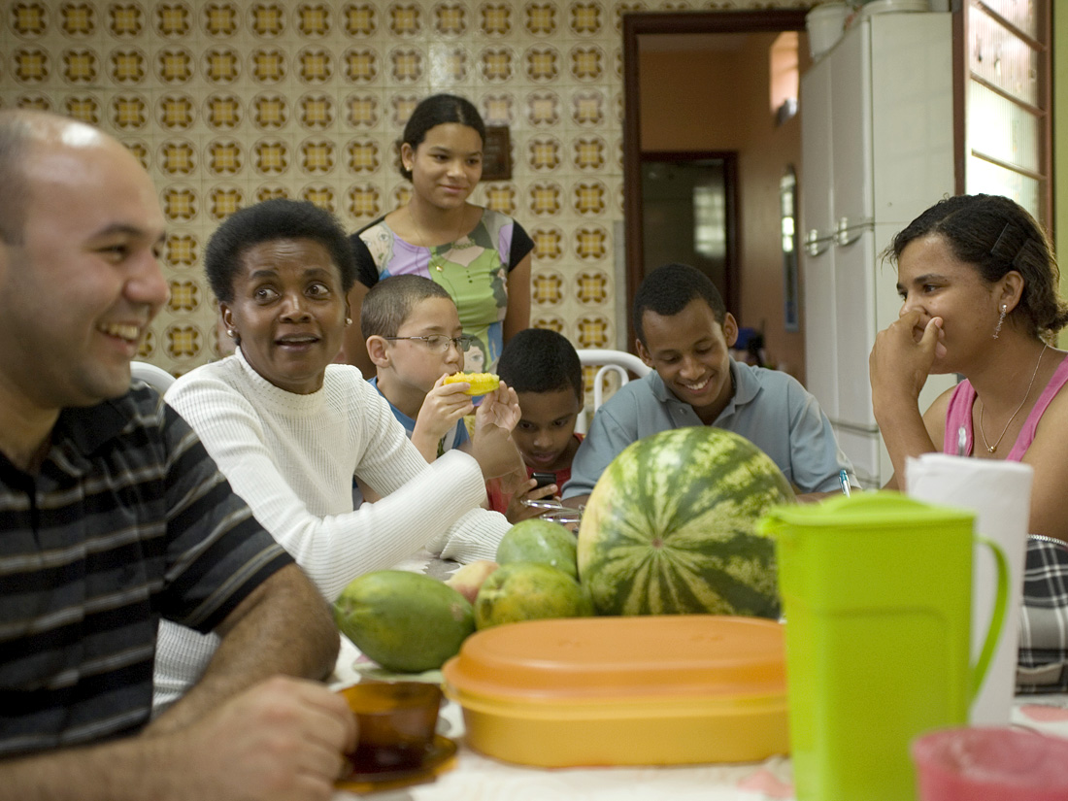
Our unique approach:
A caring family environment
Notes:
SPEAKER’S NOTES:
Everything we do is oriented towards making sure that every child grows up in a caring family environment, where the child can be a child. That environment includes care, education, healthcare, and a social support network.
The preferred solution is always for the child to stay with their existing family – and we work with families of all types to enable them to provide a loving home for their children.
When children can no longer stay with their families, we provide them with a loving home in an SOS family.
The love of a carer is essential. In our SOS Children’s Villages, the SOS mother builds a close relationship with every child entrusted to her. As a child-care professional, she lives together with her children, guides their development and runs her household independently.

Slide 11
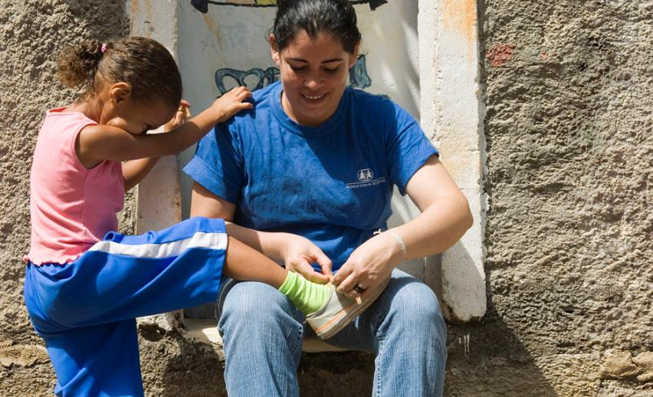
Our unique approach:
Long-term and resilient relationships
Notes:
SPEAKER’S NOTES:
We provide support over the long term, so that each child or young person can develop resilient relationships and face life’s challenges in the future.
We continue our support until young people are ready to become independent.
We focus on enabling the child to really be themselves, and ultimately to be responsible for their own decisions and actions.

Slide 12
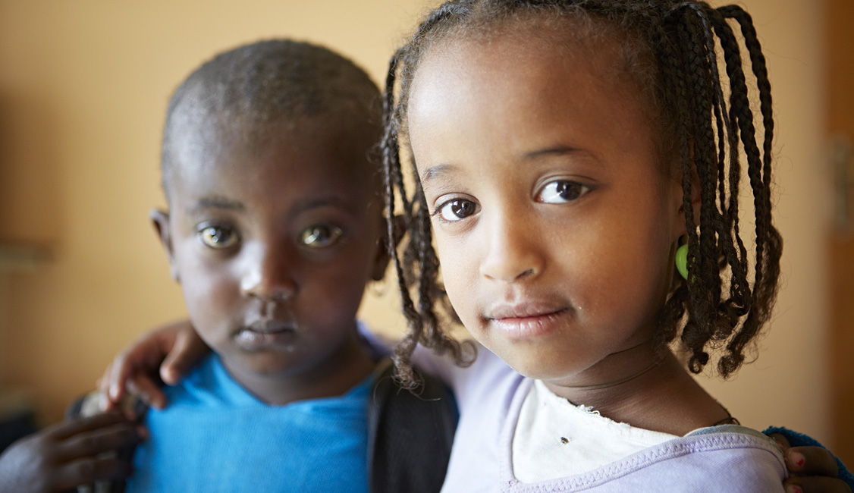
Our unique approach:
Brothers and sisters stay together
Notes:
SPEAKER’S NOTES:
Remember that our aim always is to keep families together.
And when children are unable to remain with their biological parents, we strive to ensure that brothers and sisters stay together.
Too often, siblings are separated when they enter alternative care. But that robs them of an important part of who they are.
Siblings offer each other invaluable support, and usually it is important for them to grow up together, so that they can keep their own shared history and build a shared future.

Slide 13
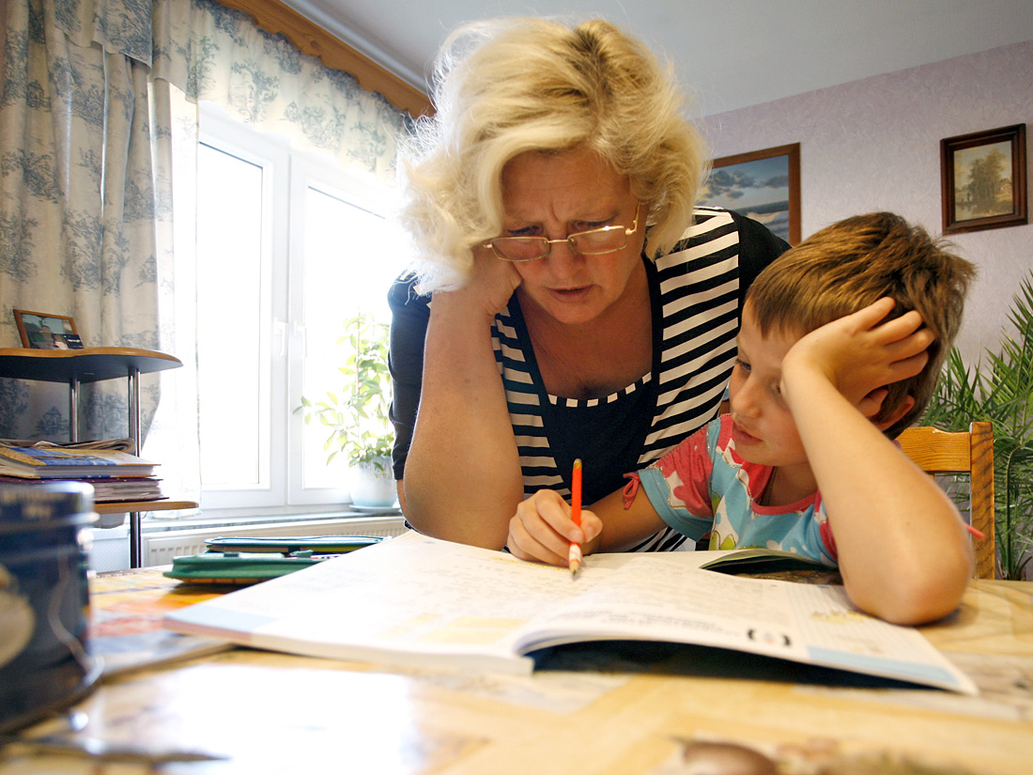
Our unique approach:
Individualised care for each child
Notes:
SPEAKER’S NOTES:
We are different from other organisations because we focus on what each individual child needs. The foundation for this is the loving family environment, but it also includes access to health care, education, and recreation.
So we get to know each child we deal with as a unique individual, and we work with them to develop a personalised plan for their development. We involve them in the decision making process.

Slide 14
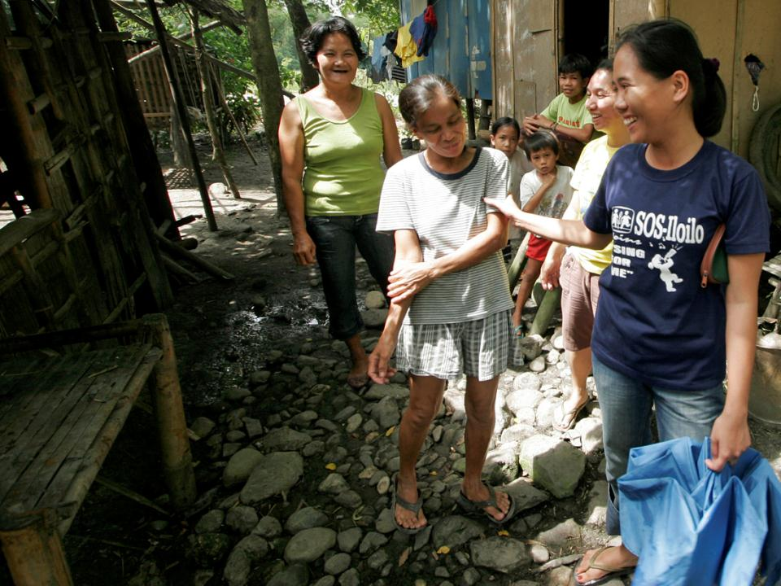
Our unique approach:
Strong social networks in the community
Notes:
SPEAKER‘S NOTES:
Children and their families are part of the community. Children should have a place where they can build their confidence and learn in a positive, supportive community. We work to make sure that families have access to support systems and social ‚safety nets‘ provided by local governments, community leaders and other responsible authorities.
When we invest in the child‘s long-term development, they grow up to strengthen the communities in which they live and indeed the whole of society.

Slide 15
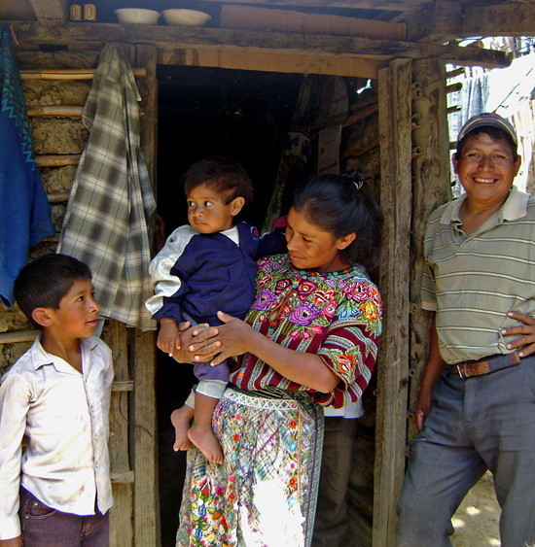
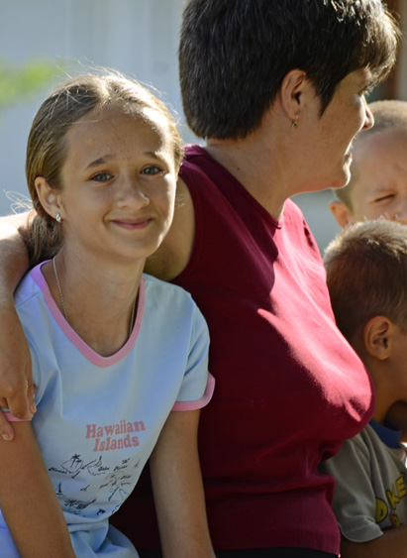
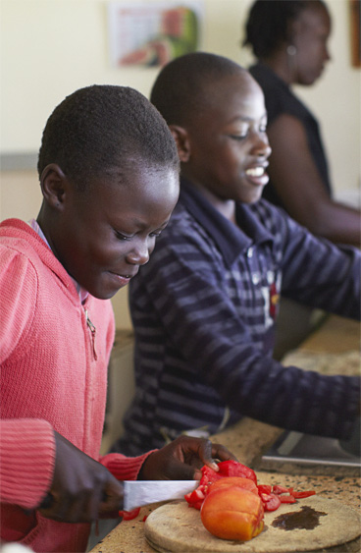
We work with different types of families:
Biological Families
SOS Families
Foster Families
Notes:
SPEAKER’S NOTES
No two families are the same!
Here are a few types of families we work with.
In biological families, we help children whose parents or other carers need support in order to take care of them through our family strengthening programmes.
Through SOS families in our SOS Children’s Villages, we help children who have lost their parents or whose parents cannot take care of them.
And we have increasingly been working with existing foster families.

Slide 16
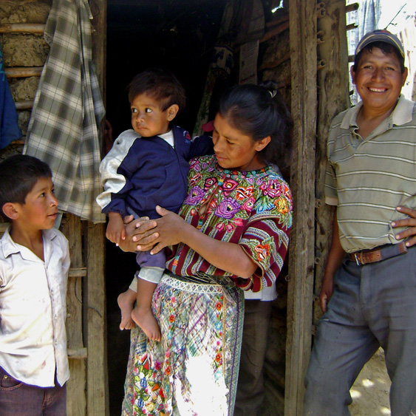
Working with BIOLOGICAL FAMILIES
483 family strengthening programmes worldwide, reaching more than 328,000 children and adults help families stay together.
Access to community services
Coaching & vocational training
Advice on raising children
Help with finances
Notes:
SPEAKER’S NOTES:
Given that the preferred option is for children to remain in their existing families, we support families in many ways.
Around the world, we run 483 Family Strengthening Programmes. In these programmes, we get to know the family and develop plans that will help them deal with the specific difficulties they are facing. And then we help them access support services, which may include:
Access to community services, which may include medical assistance, legal counsel, or education.
Coaching and vocational training for parents – to help them develop the skills they need to run a home and earn money.
Advice on raising children – practical support
Help with finances – which may include advice on budgeting, or even accessing small loans.

Slide 17
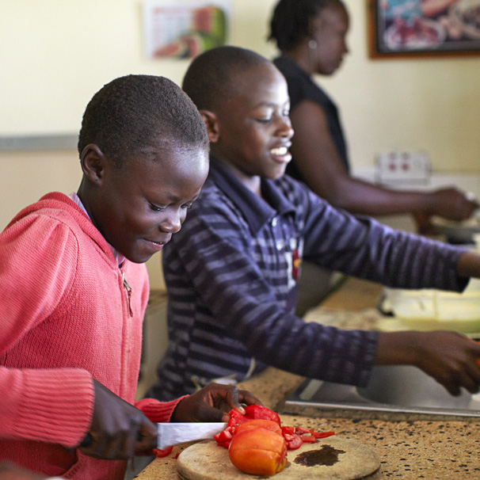
Working with SOS FAMILIES
More than 60,000 children are growing up in
6,400 SOS families worldwide
Care of a mother
Loving home
Supportive community
Notes:
SPEAKER’S NOTES:
When children can no longer stay with their families, we provide them with a loving home in an SOS family.
In the Children’s Villages, children are cared for by an SOS mother, who builds a close relationship with every child and provides the security, love and stability that each child needs. As a child-care professional, she lives together with her children, guides their development and runs her household independently.
The SOS mother creates a loving and nurturing environment where children can always feel at home.
The SOS Children’s Village is a real part of the community, and children have access to a range of support networks.

Slide 18
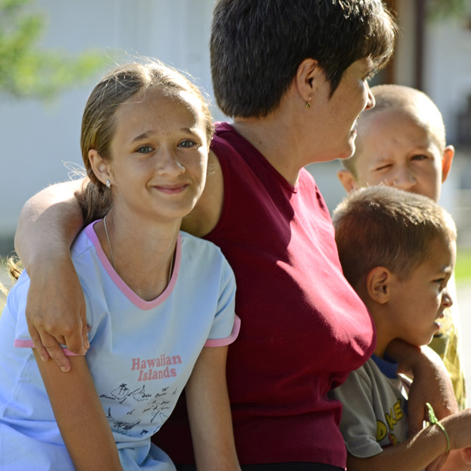
Working with FOSTER FAMILIES
More than 500 foster families worldwide are receiving support from SOS Children’s Villages
Training and support for exisiting foster parents
Primary responsibility
Transition of families from SOS to the state system
Notes:
SPEAKER’S NOTES:
We have been working more and more with foster families.
In every country, the relationship between SOS Children’s Villages and the state foster care system is slightly different. So our support might include:
Training and other types of support for existing foster families – we draw on our experience from creating SOS families to advise foster parents on how to address some of the difficult challenges they all face.
In some cases, we take primary responsibility and ongoing support for the training and supply of foster parents. This care might be provided either in the individuals’ own houses, or through SOS facilities.
And in other cases, SOS families are making a transition from living within an SOS Children’s Village setting to being a part of the state’s foster family system. Sometimes, the main legal responsibility for the child shifts from SOS Children’s Villages to the individual caregiver, but with continued support provided by SOS.
We also work with childcare authorities to help them improve their existing foster care systems.

Slide 19
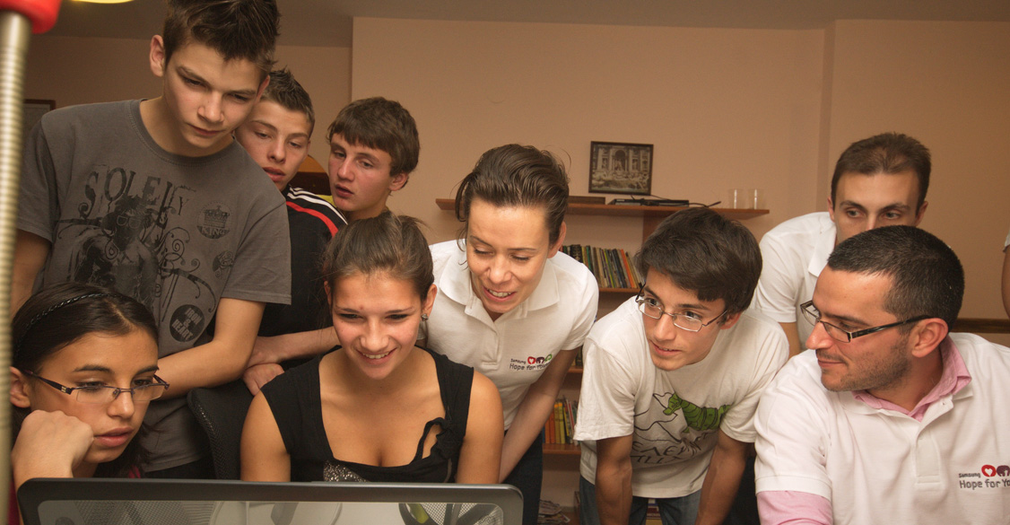
Youth Programmes
More than 20,000 young people supported through
640 youth programmes worldwide.
Education and employment opportunities
Safe housing
Emotional and social support
A voice
Notes:
SPEAKER’S NOTES:
Our aim is to enable children to develop into adults who have the skills to take responsibility for themselves and contribute to their communities.
Young people are supported through free housing or various other youth programmes, which provide...
Education/Employment: We help young people develop the knowledge and skills that will help them find good employment and prepare them for the future.
Housing: We provide adequate housing that offers security, good living conditions and easy access to amenities, employment, education and leisure facilities.
Emotional and social support: Many young people in our care come from difficult or even traumatic backgrounds. We help them develop the emotional stability and social networks they need to grow into adults who to take responsibility for themselves and contribute to their communities.
A voice: Many young people are not involved in decisions that deeply affect their lives. By supporting youth participation in peer research, debate and formulation of policy, SOS Children's Villages gives young people a voice.

Slide 20
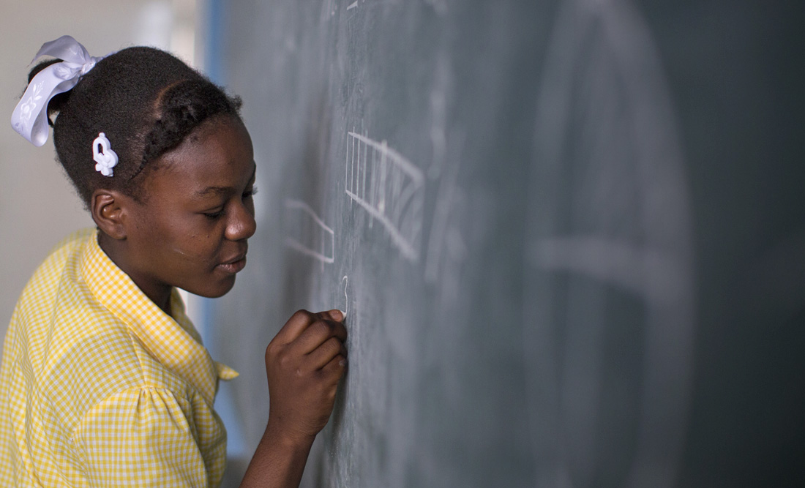
Education and Development
More than 130,000 children attend one of our 400 kindergartens or primary schools; and more than 16,000 young people and adults benefit from vocational training
Education is a human right
Enable children to develop into responsible adults
Local needs and cultural sensitivities
Notes:
SPEAKER’S NOTES:
Education is a human right, and much of our work involves ensuring that children’s rights to an education are realised.
We help people of nearly all ages, from children to adults.
About 23,000 children go to school in our SOS Kindergartens
More than 107,000 children go to our Hermann Gmeiner primary schools
About 16,000 adults learn job-related skills in our vocational training centres
Our aim is to enable children to develop into adults who have the skills to take responsibility for themselves and contribute to their communities. We help children to recognise and express their own individual abilities, interests and talents.
We enable children to live according to their own culture and religion; our schools do not impose any particular philosophy or religion. We work closely with local authorities and ensure that the educational facilities we provide meet local needs and serve to benefit the community in the short and long term.

Slide 21
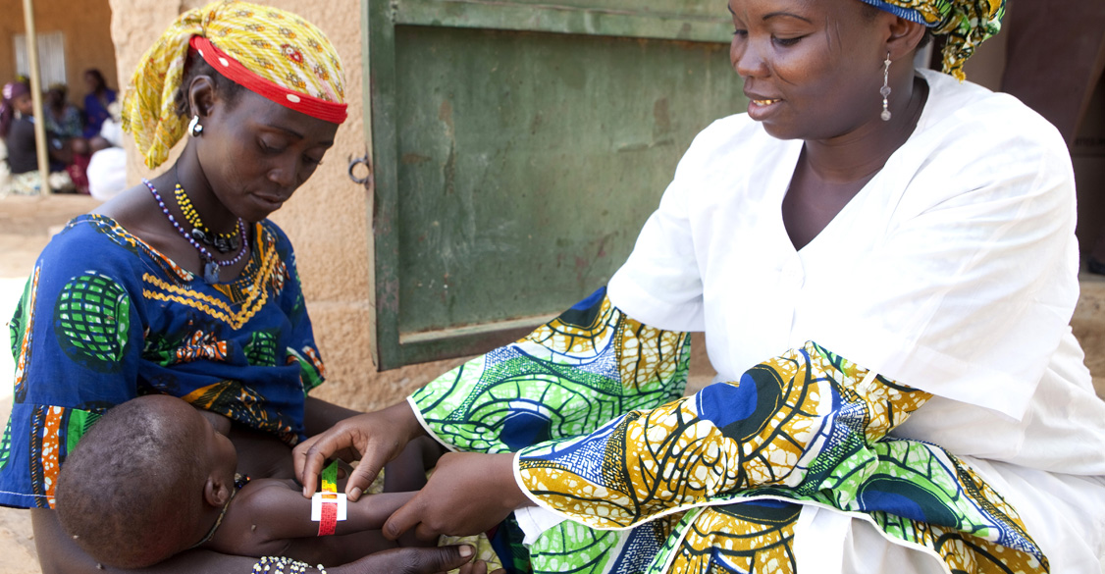
Maternal and child healthcare
75 SOS medical centres offering 794,000 single services and 62,000 service days help families stay healthy.
Specialised care for women and children
Nutrition, first aid & hygiene
Support for children with emotional, social and mental problems
Specific support for HIV/AIDS
Notes:
SPEAKER’S NOTES:
We give children and families access to medical professionals and provide individualised care.
In the communities where there is greatest need, we establish medical centres, which provide short and long-term treatments. The 794,000 single services refer to short visits, for example to receive a vaccination or other medicine
The 62,000 service days refers to when patients remain in the facility for a day or longer
These have a focus on specialised care of women and children (including vaccines and childbirth facilities).
We also provide guidance on nutrition, first aid and hygiene.
We help children deal with emotional, social and mental problems.
Around 90% of our social and medical centres specifically support families and children affected by HIV/AIDS.

Slide 22
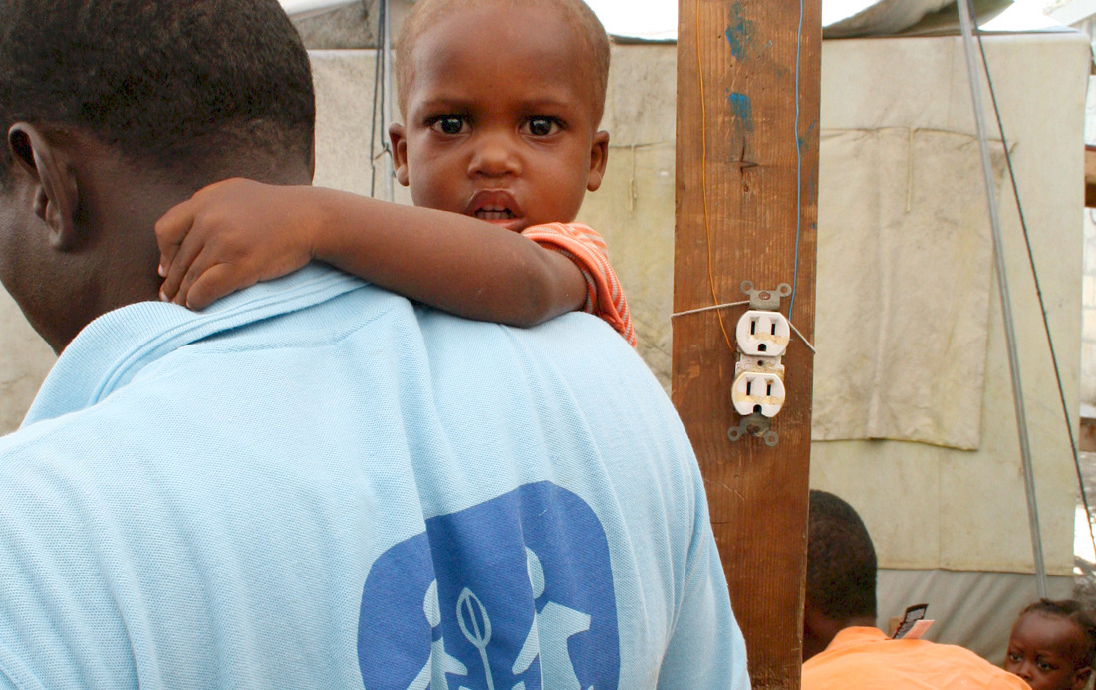
Emergency Relief Programmes
About 218,000 single services provided through
SOS Emergency Relief Programmes
Protection of unaccompanied and separated children
Reunion with their families
Suitable alternative care placement if necessary
Psychological support
Notes:
SPEAKER’S NOTES:
Although we are not primarily a humanitarian aid organisation, we do run emergency relief programmes where we already have one of our existing programmes in place. In those locations, when disasters strike, SOS Children’s Villages is in a strong position to promptly respond with an established infrastructure whenever children and families most need urgent assistance.
Our emergency programmes are not permanent, and we had 7 running at the end of 2013.
In situation of crisis – whether caused by war, natural disaster or other events – children in particular require specific protection and care, especially those who are separated from their families.
A large part of our emergency work in Haiti following the earthquake in 2010 was to help reunite children with their families.
If the children have no families, we take action to bring them as quickly as possible from the emergency situation into a caring family environment where their development as individuals is supported.
Very frequently, children in these situations are traumatised and need extra psychological support.
In many cases, projects that start out as a part of emergency relief work become permanent SOS programmes.

Slide 23
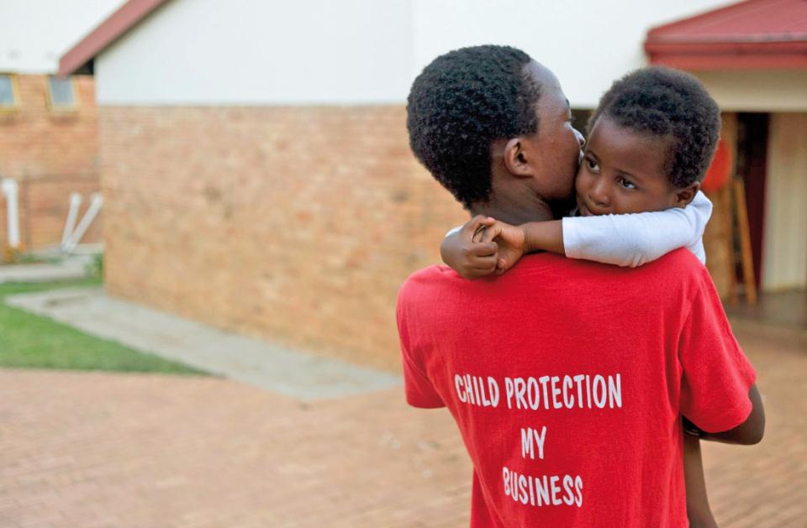
Advocacy
We actively promote and stand up for children‘s rights.
Encouragement of governments to meet their responsibilities towards children at risk
Partnerships with other NGOs, UN agencies, governments, community-based organisations
Child and youth participation in decision-making processes
Notes:
SPEAKER’S NOTES:
We actively promote and stand up for children’s rights.
We encourage governments to meet their responsibilities and help children at risk. Our ‘Care for ME!’ campaign is working in more than 60 different countries to ensure that governments fulfill their responsibilities and improve the quality of care that children in alternative care are receiving.
We work in partnerships with other NGOs, UN agencies, governments, and community organisations to create a strong and supportive environment for children.
We encourage children to actively take part in decision-making processes that affect their lives and whenever possible to represent themselves.

Slide 24
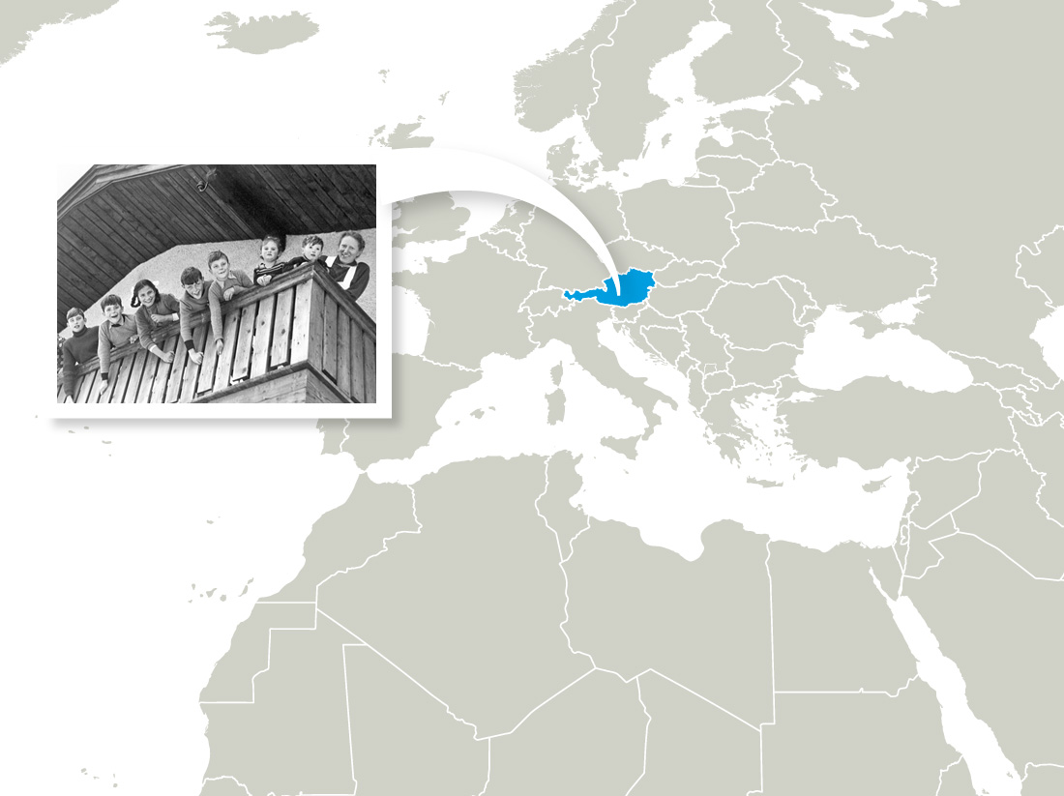
Our expanding geographic reach…
1949
The first SOS Children‘s Village built in Imst, Austria
Notes:
SPEAKER’S NOTES:
In 1949, the first SOS Children's Village opened in Imst, Austria.

Slide 25
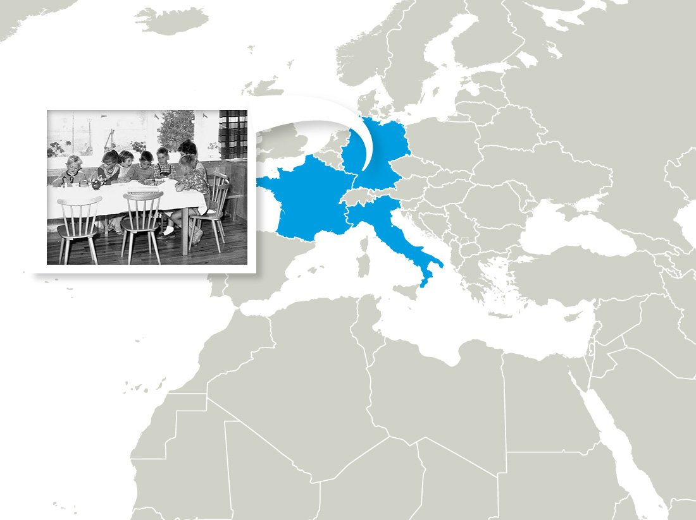
Our expanding geographic reach…
1955
Associations founded in Germany, France and Italy
Notes:
SPEAKER’S NOTES:
In 1955, associations were established in Germany, France and Italy.

Slide 26
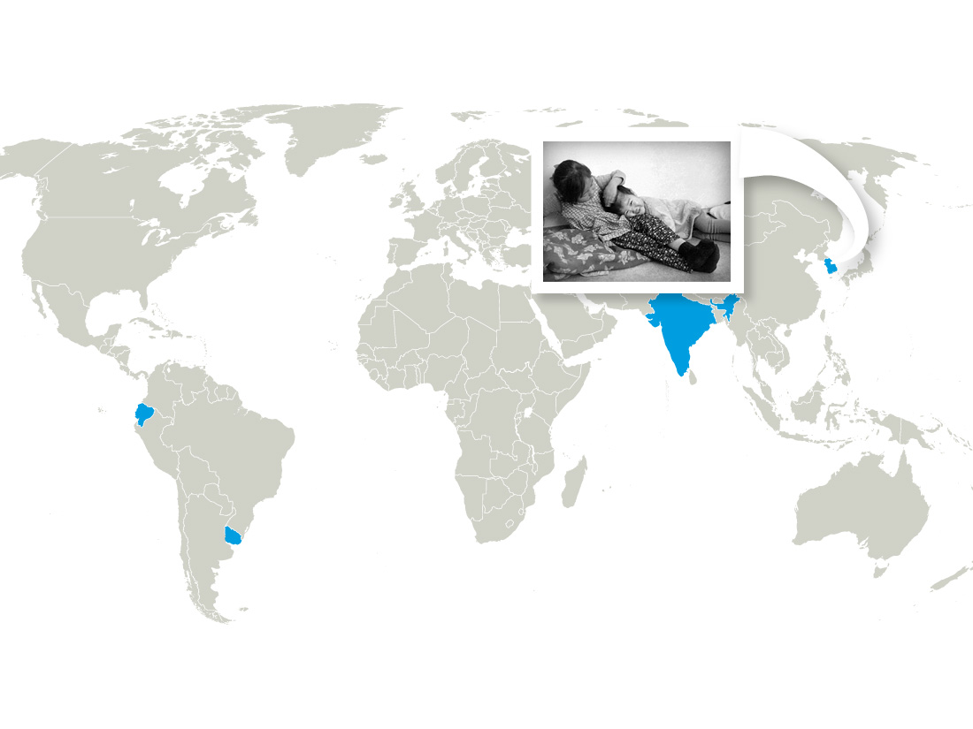
Our expanding geographic reach…
1960s
Start of our international work outside Europe, in Asia (South Korea, India) and Latin America (Uruguay, Ecuador)
Notes:
SPEAKER’S NOTES:
In the 60‘s, SOS Children‘s Villages made the leap to start working outside of Europe: in Asia (South Korea and India) and Latin America (Uruguay and Ecuador).

Slide 27
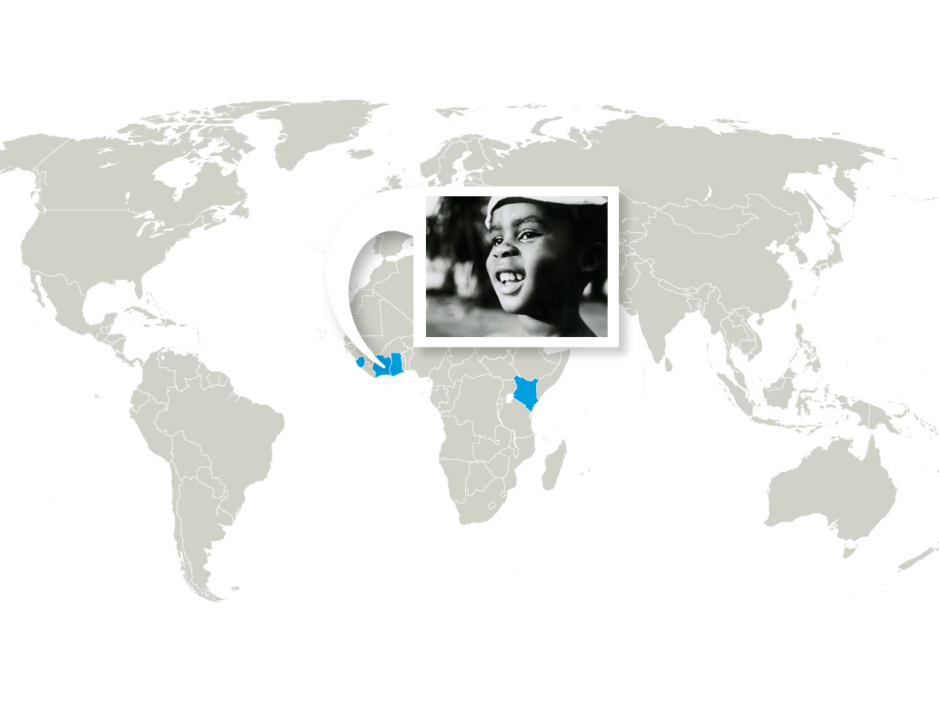
Our expanding geographic reach…
1970s
First African SOS Children's Village built in Côte d'Ivoire; programmes started in Ghana, Kenya and Sierra Leone.
Notes:
SPEAKER’S NOTES:
In the 70’s, we went to Africa, starting with Côte d'Ivoire - soon, first programmes also started in Ghana, Kenya and Sierra Leone.

Slide 28
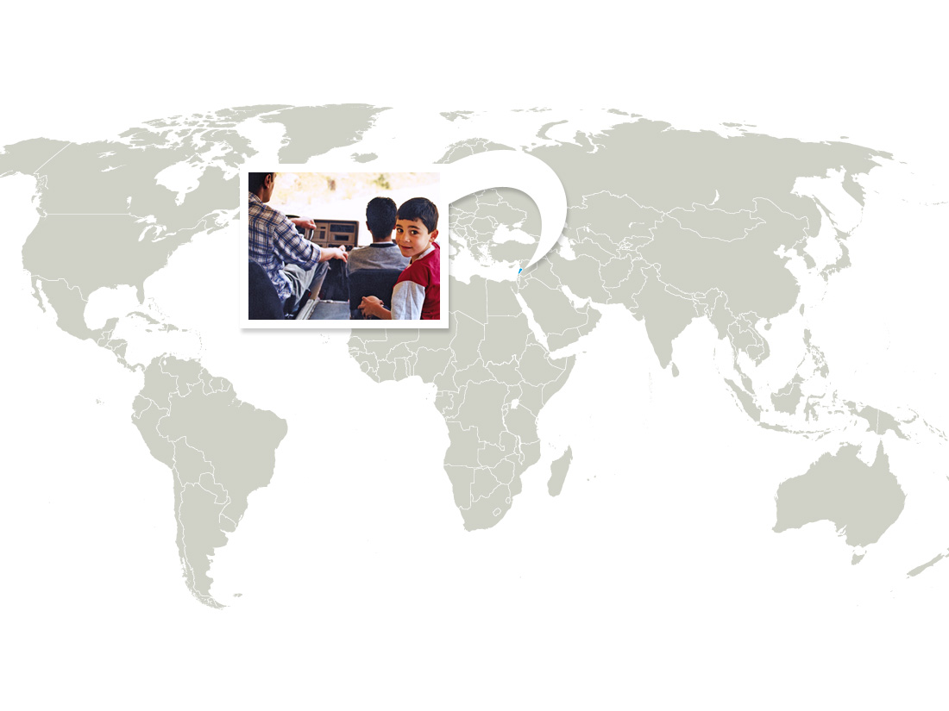
Our expanding geographic reach…
1984
“Neighbourhood assistance” starts in Lebanon and later becomes “family strengthening programmes”
Notes:
SPEAKER’S NOTES:
In 1984, SOS Children’s Villages Lebanon started up an assistance programme to help war widows and their children from the neighbourhood by providing shelter, help with financial problems and basic vocational training. During the 1990’s such family strengthening programmes became a part of SOS Children’s Villages’ portfolio, thus empowering parents to better care for their children.

Slide 29
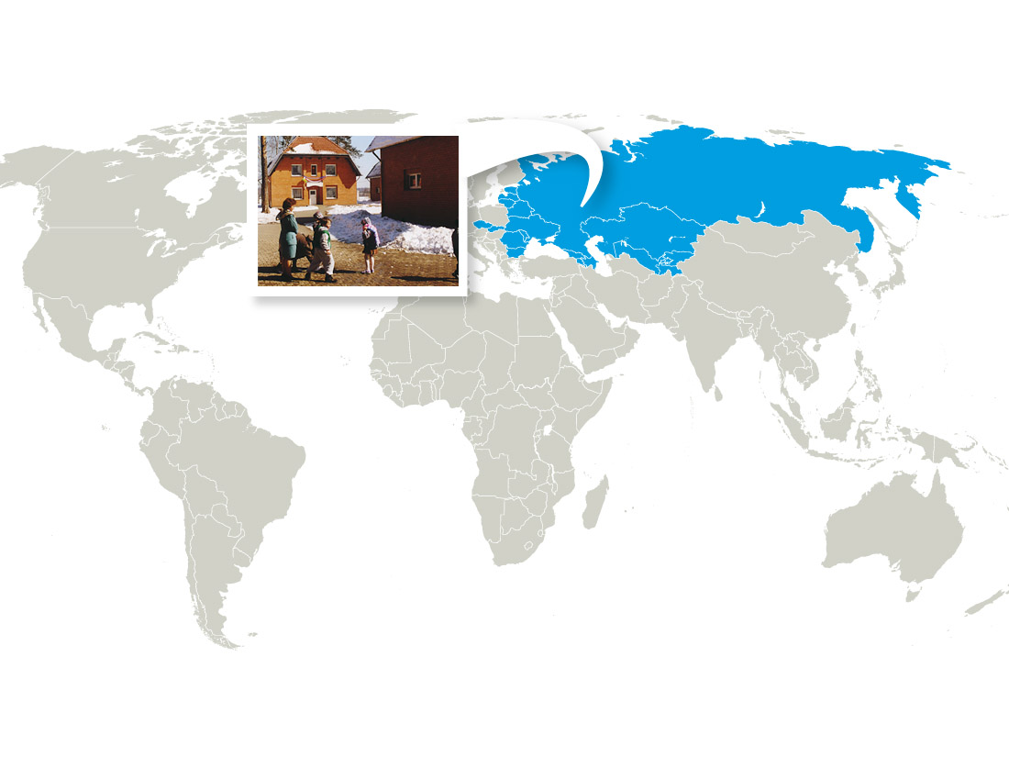
Our expanding geographic reach…
1990s
Expansion of our programmes in Eastern Europe: Czechoslovakia, Soviet Union, Bulgaria and Romania
Notes:
SPEAKER’S NOTES:
After the fall of the iron curtain, SOS Children’s Villages’ work expanded into Eastern Europe: Czechoslovakia, Soviet Union, Bulgaria and Romania.

Slide 30
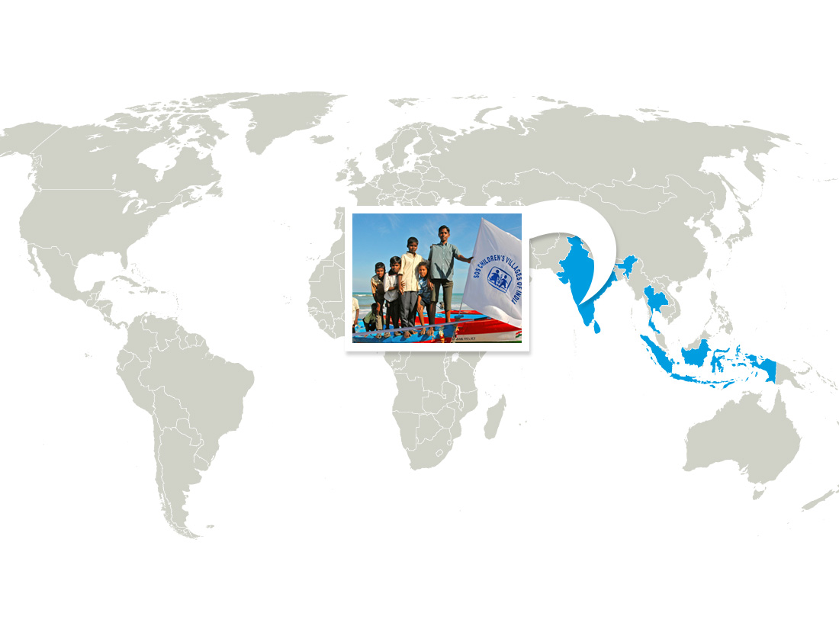
Our expanding geographic reach…
2000s
2004 Southeast Asia tsunami triggers biggest emergency relief programme in SOS Children’s Villages’ history
Notes:
SPEAKER’S NOTES:
Although Hermann Gmeiner started setting up “emergency teams” as early as the 1970’s, no emergency programme had the scale of the one following the 2004 tsunami in Southeast Asia that claimed over 230,000 lives.
Around 23,000 people received direct support, 6 new SOS Children’s Villages, more than 2,200 family houses and some 20 social and educational facilities were built.
Helmut Kutin once called the programme a "monument of love and care”.

Slide 31
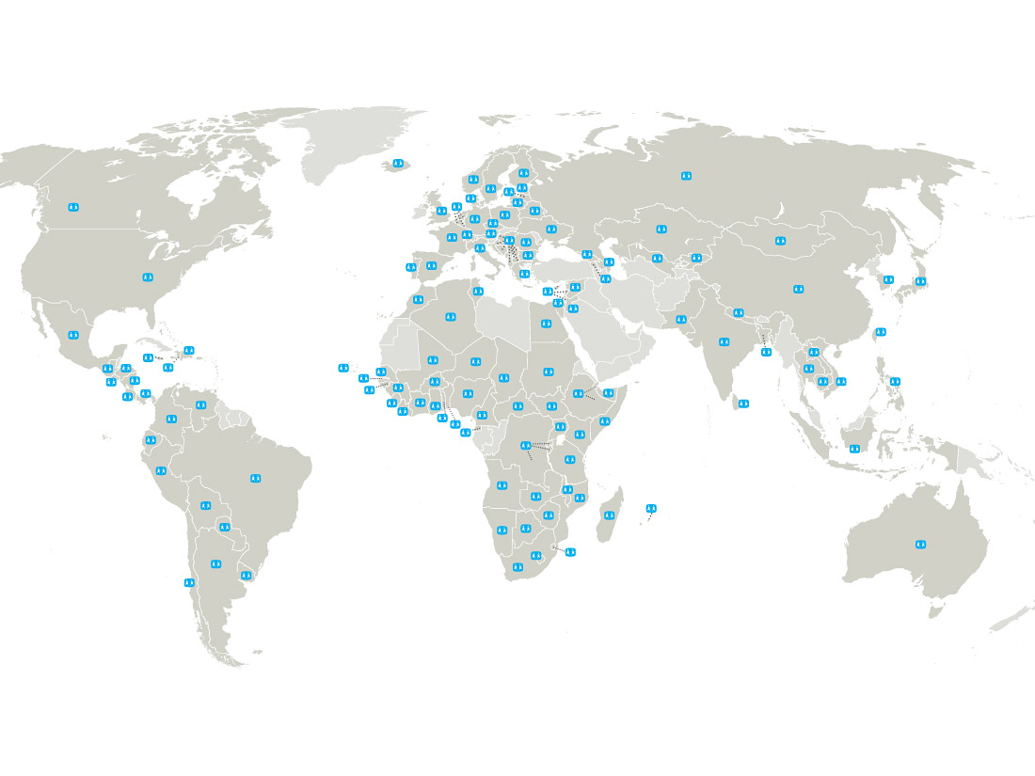
Our expanding geographic reach…
today
SOS Children‘s Villages is working in 134 countries and territories around the world.
Notes:
SPEAKER’S NOTES:
Today, the organisation is present in 134 countries and territories

Slide 32


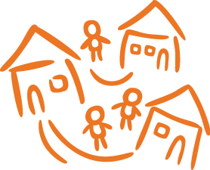
Working with Standards
INTERNATIONAL STANDARDS:
UN Convention on the Rights of the Child
UN Guidelines on the Alternative Care of Children
Quality4Children
Millennium Development Goals
International Red Cross & Red Crescent code of conduct
FINANCES & ACCOUNTABILITY:
INGO Accountability Charter
International Accounting Standards Board
SOS anti-fraud and anti-corruption guidelines
SOS Good Management and Accountability Quality Standards
OUR OWN POLICIES:
SOS Children‘s Villages Programme Policy
Child Protection
Inclusion
HIV/AIDS
Formal Education
Emergency
Code of Conduct
Notes:
SPEAKER’S NOTES:
There are many International Standards that guide our work, mainly relating to the rights of children, the quality of care that they should received, and the way we respond to humanitarian emergencies.
In addition, we recognise that to maintain our donors‘ trust, we need to be very transparent and rigorous in how we manage and report on our finances. So these accountability standards are important. All financial transactions are recorded in accordance with national laws and SOS accounting standards based on international accounting standards. In addition, external audits are conducted by independent, internationally recognised auditors.
Finally, over the years we have developed a number of policies and guidelines that ensure that we are clearly focused – with the SOS Children‘s Villages Programme Policy providing the framework. Other, more specific policies help us to protect the privacy, safety and idividuality of every child and adult we work with.

Slide 33
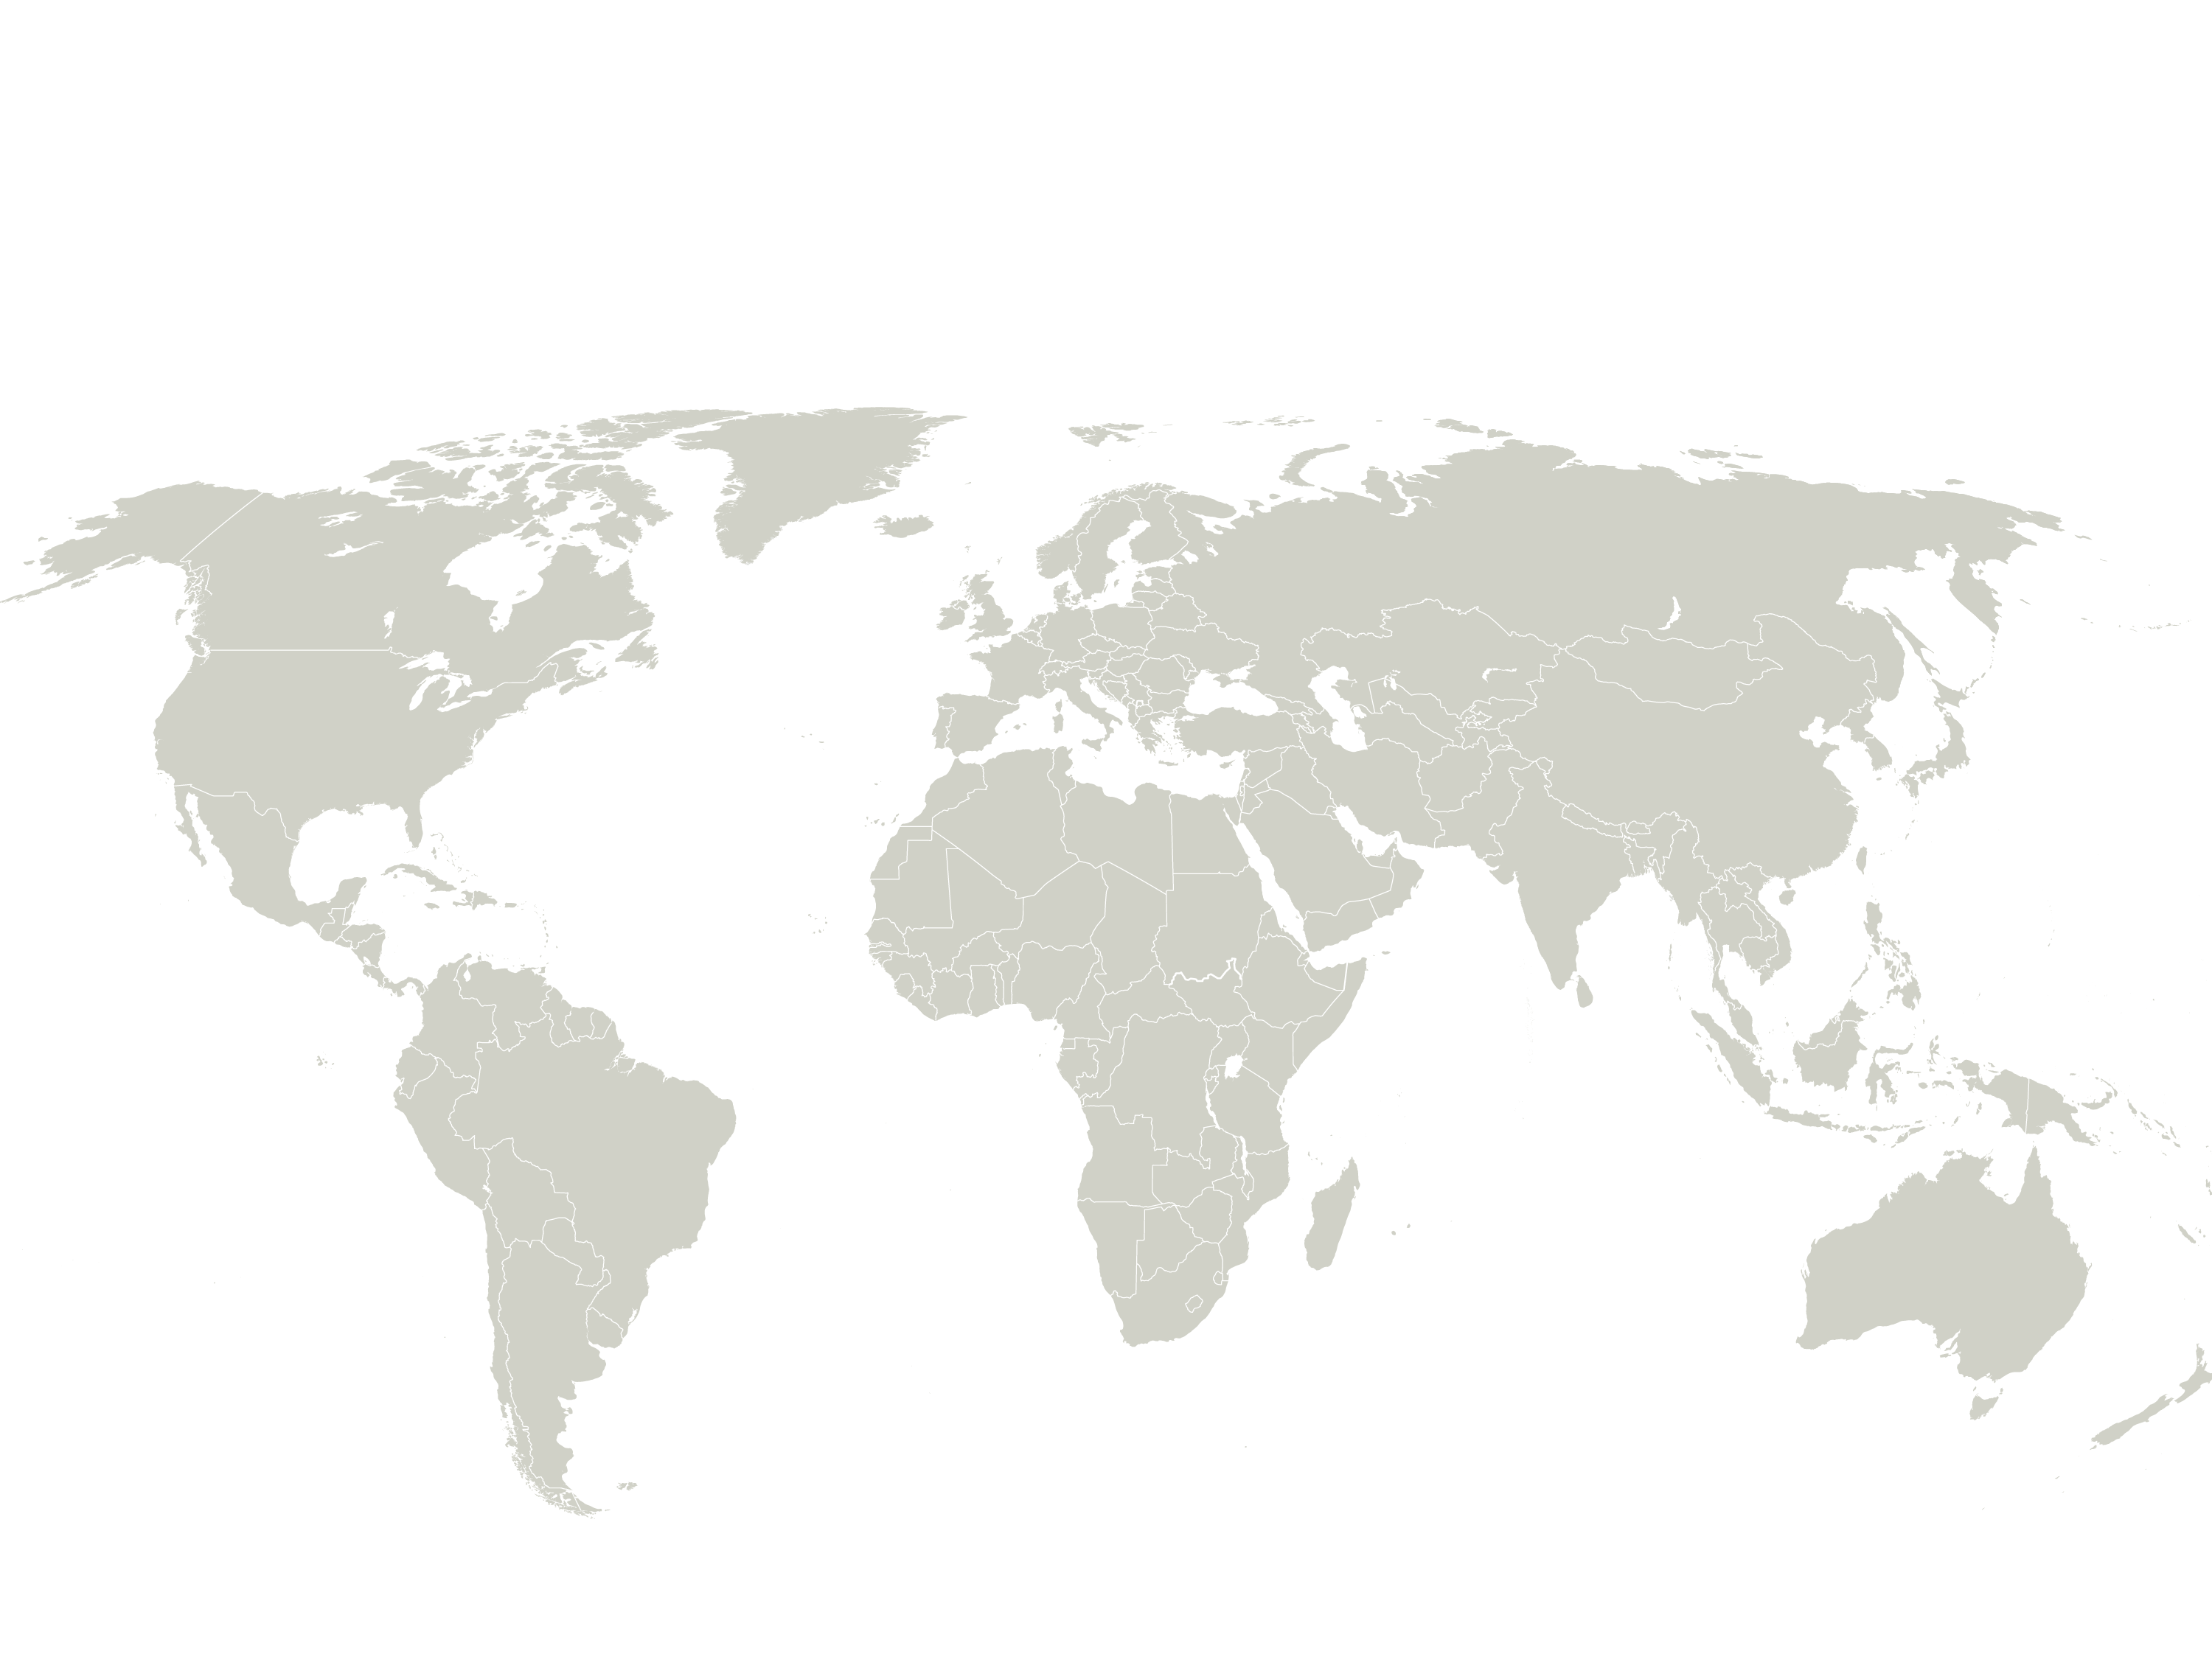
Where the children live
410,800 children, youth
and parents globally*
18,100
Central & Eastern Europe, CIS, Baltics
21,200
Western Europe
& North America
101,600
Latin
America
Asia
Africa &
Middle East
160,400
109,500
* in SOS Children‘s Villages, youth programmes and family strengthening programmes
Notes:
SPEAKER‘S NOTES:
We are helping children and their parents all over the world. Here are the numbers of individuals we help through our core work: Children’s Villages, youth programmes, and family strengthening programmes.
[Note: Numbers can be cross-referenced with the Online Directory by adding up these numbers: CV, YF1, YF2, FSP 0-17, FSP 18+. Numbers as of 1 January 2014]

Slide 34

Where the money comes from
One-off donations
30%
Sponsorships / committed giving
21%
Major donors
3%
Foundations / Lotteries
3%
991
Total income
Corporate Donors
4%
million
worldwide
EUR
2013
Governmental subsidies
for domestic programmes
27%
Institutional funding
2%
10%
Other income
Emergency appeals
1%
Notes:
SPEAKER‘S NOTES:
So, where does our money come from?
The biggest chunk of it comes from individual people. 30% of our income is from single donations from ordinary people.
Add to that the 21% that comes from sponsorships and other forms of regular (usually monthly) donations, and you see that slightly more than half of our income is from individuals.
Another large chunk – 27% -- comes from governments who pay us to run programmes for them in their countries.
The rest are fairly small proportions:
3% from major donations – large amounts given by wealthy people
3% from foundations or lotteries
4% from companies that we partner with (though this number does not include the value of non-financial aspects of the partnership, such as donations of equipment or employee volunteering)
1% from governments who fund international work
The 9% from ‚Other Income‘ is from such non-fundraising sources – including, for example, the sale of assets, rental income from properties we own, interest from bank deposits, fees charged in vocational training centres, etc.

Slide 35
Expenditures by type
65%
Programme support (SOS villages youth
programmes, kindergartens, vocational
training programmes, family strengthening
programmes and medical centres)
19%
Information and fundraising work
in PSAs
8%
Other programmes
Total
975
expenditure
million
3%
Construction and investment
funds from SOS Promoting and Supporting Associations
worldwide
2013
EUR
*
1%
Emergency relief
4%
International coordination and
programme support
Notes:
SPEAKER‘S NOTES:
This graphic reflects the different types of programmes we spend money on.
[In 2013, there were no breakdowns available for specific types of programmes (CVs, YFs, FSPs, MCs etc). These were available in 2012 and hopefully will be available again in the future.]

Slide 36
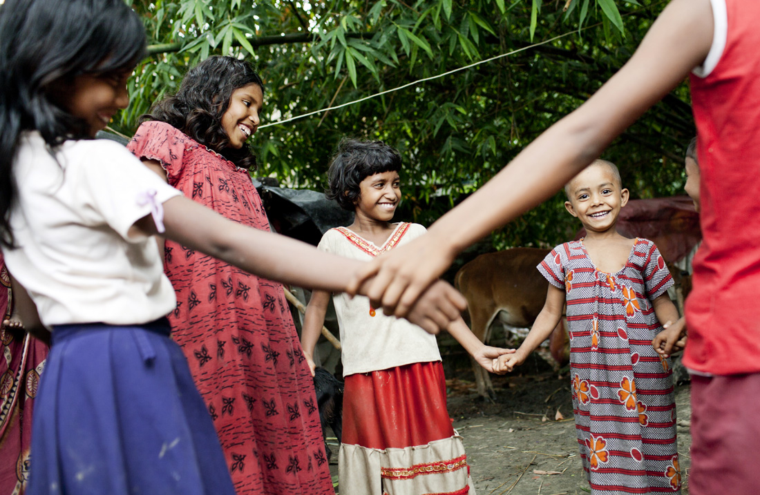
Together we can achieve more!
OUR PARTNERS:
Individual donors
4.2 million individual supporters worldwide
Institutional donors
e.g. ECHO, Norad, Austrian Development Cooperation, BMZ, etc...
Corporate Partners
e.g. Microsoft, Allen & Overy, Deutsch Post DHL, HSBC, etc...
Other NGOs
e.g. Habitat for Humanity, Plan International, Unicef
Notes:
SPEAKER‘S NOTES:
For over 60 years, we at SOS Children’s Villages have been committed to supporting children at risk around the world. However, we need regular support from friends, corporate partners, governments and other organisations who share our values. So we work very hard at developing strong partnerships.
Individual donors:
Since the very start, we have relied on individual donors. The vast majority of our income comes from one-off donations and committed giving. Individual donors also respond to our appeals when there is an emergency or any specific fundraising appeal.
Figures from 2011:
3,481,768 sporadic donors
383,881 committed givers
375,804 sponsors
TOTAL 4,241,453 supporters worldwide
Governments and institutional donors:
We have always worked closely with domestic governments to deliver services, and in recent years, partnerships with institutional donors who work internationally have increasingly become an important part of our work. They go beyond financial arrangements as they build relationships that shape thinking and policies of those involved in development cooperation. Examples:
ECHO - Directorate for Humanitarian Aid and Civil Protection of the European Commission;
Norad – The Norwegian Agency for Development Cooperation
Austrian Development Cooperation
BMZ – Federal Ministry for Economic Cooperation and Development
The Belgian Development Cooperation
Ministry of Foreign Affairs Luxembourg
Ministry of Foreign Affairs of the Netherlands
Corporate Partners:
We build exciting, long-term, sustainable relationships with our corporate partners that allow us to have a meaningful and sustainable impact on the lives of children. Examples: Microsoft, the global law firm Allen & Overy, Louis Vuitton, HSBC, Deutsche Post DHL
International Agencies and other NGOs:
We believe that two organisations can achieve greater impact by working together than by working separately, and we have developed relationships with many other organisations who share our vision. Examples: Habitat for Humanity, Plan International, Unicef, Council of Europe

Slide 37
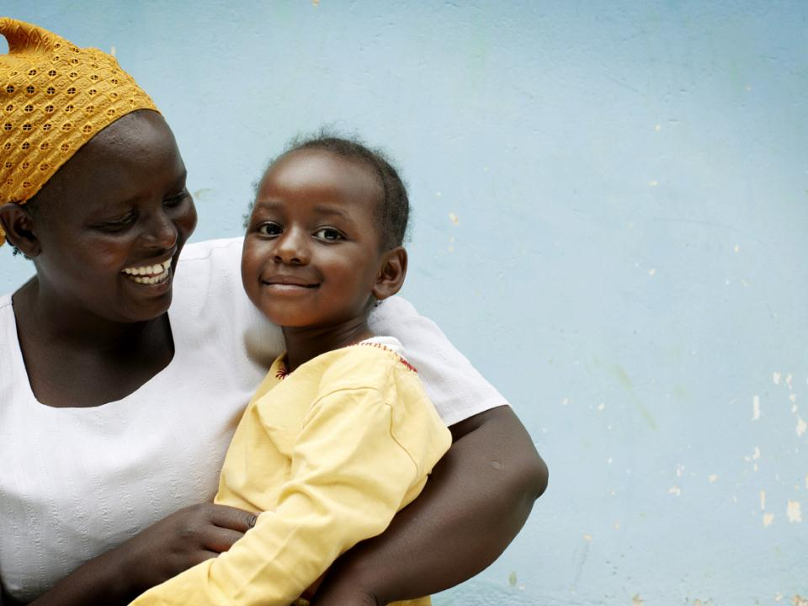

“Good things happen when people do more than they have to.”
Hermann Gmeiner, founder of SOS Children’s Villages
www.sos-childrensvillages.org

Slide 38
How can YOU and Worldskills help? Our goal is, to teach schoolchildren all over the world about the cause and get them engaged. The material you all produce, will be distributed from the organization to teach children in a fun way.

Slide 39
What will we make? TASK 1 Make a fun, happy and creative house for children. It should have details the children will enjoy to look at and talk about. The house must have: Background colour. Windows, doors or other openings to let light through. It must have an opening big enough to insert LED candle (Provided)

Slide 40
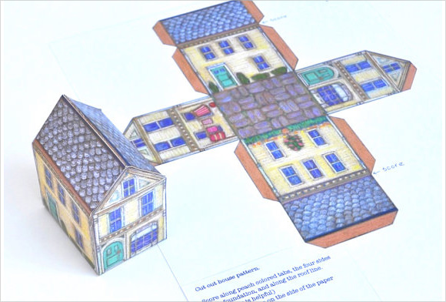
Sample:

Slide 41
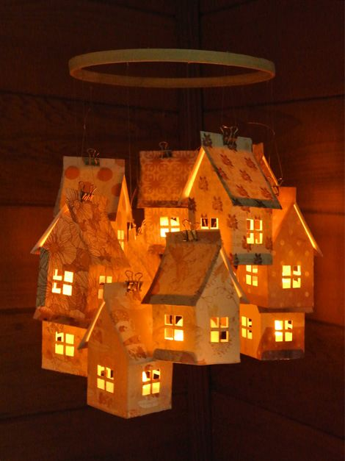
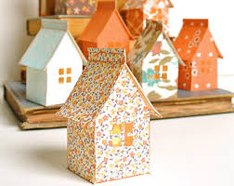
Sample:

Slide 42

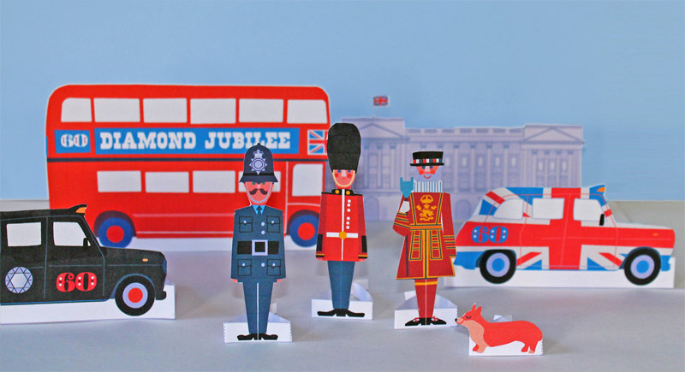
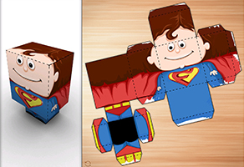
Task 2: ”A child should never be alone” Make two figures of persons. It can be child, teacher or other.

Slide 43
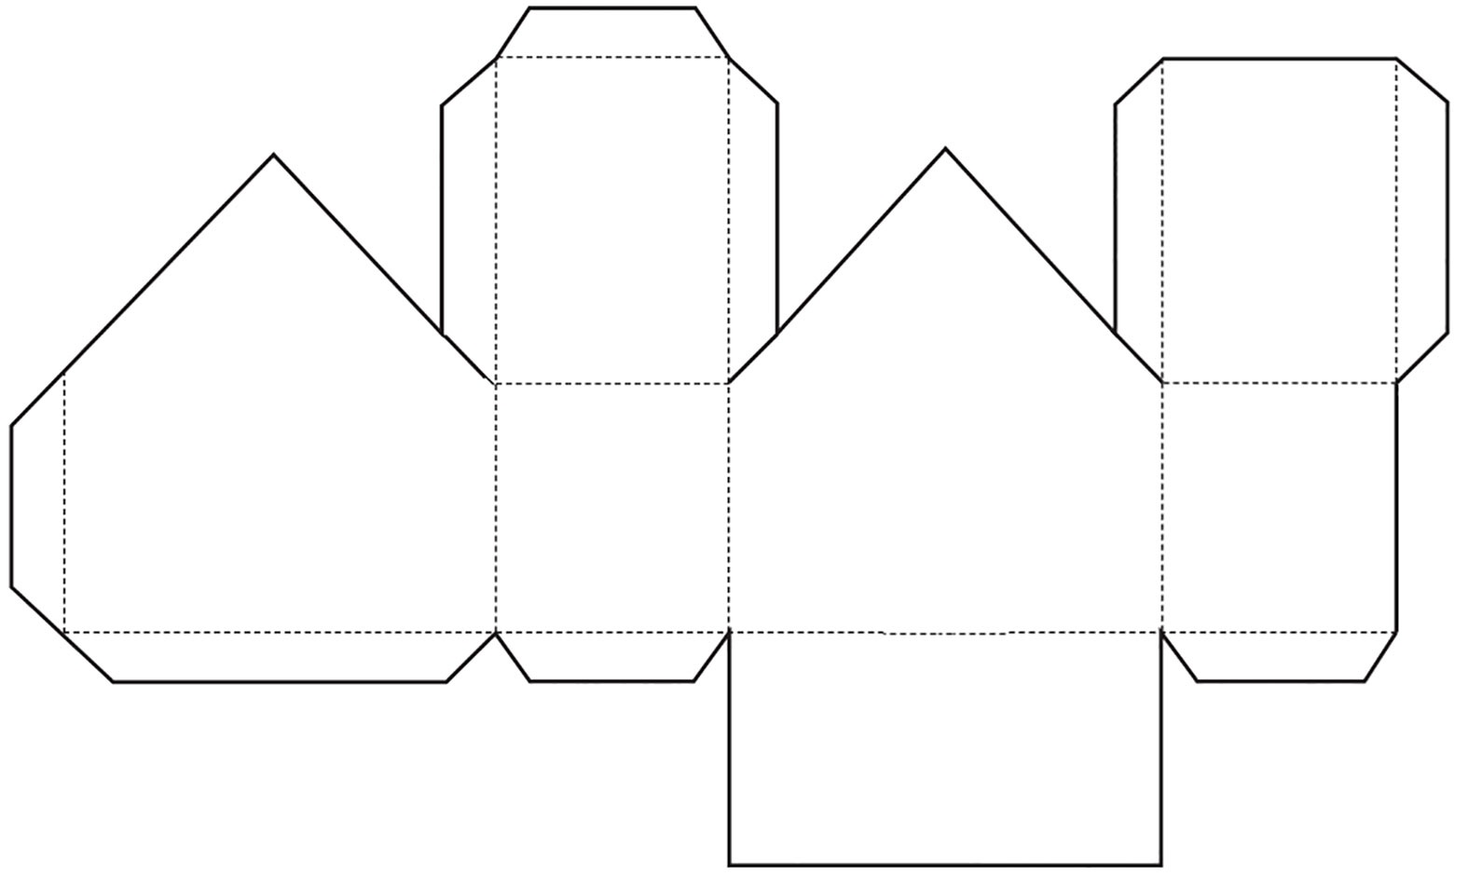
The children will also have your dieline only for their own version:

